Slide 1
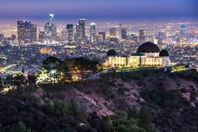
College Name Here
School Colors |  |  | Mascot
Location |  | Type of School | Setting (include new city photo)
% female % male Student Ratio |  | Total Students | $ in-state tuition $ out-of-state tuition
Fall Application Deadline |  | % Acceptance Rate | Admission Difficulty
Average test scores for all first-year students that were accepted and enrolled. | SAT math | SAT reading | SAT writing | ACT composite

Slide 2
University of California, Los Angeles
Blue and Gold School Colors |  |  | Bruin Mascot
Los Angeles, CA Location |  | Public Type of School | Urban Setting
56% female 44% male Student Ratio |  | 29,585 Total Students | $11,220 in-state tuition $35,928 out-of-state tuition
November 30 Fall Application Deadline |  | 17% Acceptance Rate | Very Difficult Admission Difficulty
Average test scores for all first-year students that were accepted and enrolled. | 665 SAT math | 634 SAT reading | 648 SAT writing | 29 ACT composite

Slide 3
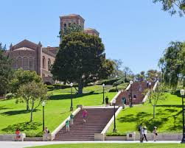
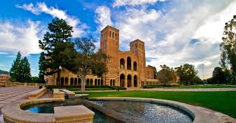
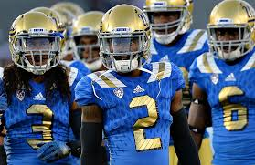
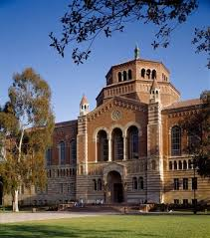

Slide 4
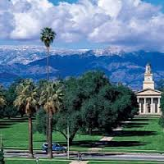
University of Redlands
Burgundy and Grey School Colors |  |  | Bulldog Mascot
Redlands, CA Location |  | Private Type of School | Small Setting
56% female 44% male Student Ratio |  | 3,493 Total Students | $44,550 in-state tuition $44,550 out-of-state tuition
January 15 Fall Application Deadline |  | 67% Acceptance Rate | Moderately Difficult Admission Difficulty
Average test scores for all first-year students that were accepted and enrolled. | 570 SAT math | 570 SAT reading | Not Reported SAT writing | 25 ACT composite

Slide 5
